Slide 1
Atlantic (Overview II)

Slide 2
Overview
Software architecture
AP architecture
  State machine
  message flow
  helpers

Slide 3
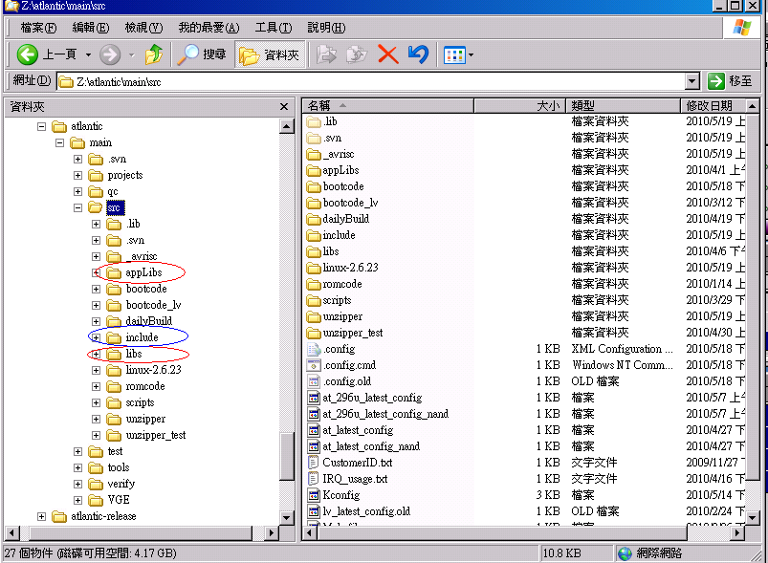
Software architecture

Slide 4
Software architecture
AP
AppLibs
Libs
ROS
linux-2.6.23
_avrisc

Slide 5
AP architecture
Main()
System_Init()
State Machine

Slide 6
AP architecture(State machine)
Hierarchical State Machine (HSM)
  State
  Event driven
    Q_ENTRY_SIG
    Q_INIT_SIG
    Q_EXIT_SIG
    User define event(message)

Slide 7
AP architecture(State machine)
  Z:\atlantic\main\projects\realtek\generic\states\srStateInc.h
  QSTATE QHsm_Active(QHsmTv *me, QEvent const *e);
  QSTATE QHsm_PowerOn(QHsmTv *me, QEvent const *e);
  QSTATE QHsm_SingleSource(QHsmTv *me, QEvent const *e);
  QSTATE QHsm_DualSource(QHsmTv *me, QEvent const *e);
  QSTATE QHsm_InstallGuide(QHsmTv *me, QEvent const *e);
  QSTATE QHsm_SimpleGuide(QHsmTv *me, QEvent const *e);
  QSTATE QHsm_SourceInput(QHsmTv *me, QEvent const *e);
  QSTATE QHsm_MainMenu(QHsmTv *me, QEvent const *e);
  QSTATE QHsm_FactoryMode(QHsmTv *me, QEvent const *e);
  QSTATE QHsm_MediaCenter(QHsmTv *me, QEvent const *e);
  QSTATE QHsm_OkList(QHsmTv *me, QEvent const *e);
  QSTATE QHsm_EPG(QHsmTv *me, QEvent const *e);
  #ifdef ENABLE_TEST_YAHOO_TV_WIDGET
  QSTATE QHsm_Ywe(QHsmTv *me, QEvent const *e);
  #endif
  #ifdef ENABLE_UI_BESTV
  QSTATE QHsm_BesTV(QHsmTv *me, QEvent const *e);
  #endif
  QSTATE QHsm_PowerOff(QHsmTv *me, QEvent const *e);
  QSTATE QHsm_PowerSaving(QHsmTv *me, QEvent const *e);

Slide 8
AP architecture(State machine)
QHsm_Active
QHsm_PowerOn
QHsm_PowerOff
QHsm_SingleSource
QHsm_MediaCenter
QHsm_DualSource
QHsm_OkList
QHsm_PowerSaving
QHsm_MainMenu
QHsm_EPG
  Q_INIT(QHsm_SingleSource);
  Q_TRAN(QHsm_MainMenu);

Slide 9
AP architecture(message flow)
Z:\atlantic\main\projects\realtek\generic\system\srUiThread.cpp
  Keyborad
  Kernel (Netlink, UDP)

Slide 10
AP architecture(message flow)
AP
Msg queue
libs
rtMessage.c API
Scaler
Si
ioMgr.c
IoMgr_Thread()
Si
socket
Linux Kernel
Notes:
Z:\atlantic\main\src\libs\utils\rtMessage.c
Z:\atlantic\main\src\libs\io\ioMgr.c

Slide 11
AP architecture(helper)
補state machine的不足。
  同一層的state，只能有一個state是Active.

Slide 12
AP architecture(helper)
Message
If helper process message ?
Y
N
State Machine

Slide 13
AP architecture(helper)
Z:\atlantic\main\projects\realtek\generic\helper\srHelperId.h
  HELPER_ID_TEMPLATE = 0,
  HELPER_ID_MSG_BOX,
  HELPER_ID_PC_BOX,
  HELPER_ID_VOLUME_BAR,
  HELPER_ID_CH_INPUT,
  HELPER_ID_INFO_BAR,
  HELPER_ID_RSS_WEATHER,
  HELPER_ID_KEYBOARD,
  HELPER_ID_KEYBOARDMOBILE,
  HELPER_ID_CONFIRMBOX,
  HELPER_ID_YAHOO_WIDGET_ENGINE_BAR,
  #ifdef ENABLE_FLASH_DEMO
  HELPER_ID_FLASH_PLAYER,
  #endif
  HELPER_ID_MAX

Slide 14
AP architecture(helper)
Example (Volume Bar)
  void VolBar_Init()
  {
  HELPER_CB_FUNCLIST cbList;
  memset(&cbList, 0, sizeof(HELPER_CB_FUNCLIST));
  cbList.activate = VolBar_Activate;
  cbList.deactivate = VolBar_Deactive;
  cbList.processMsg = VolBar_ProcessMsg;
  // helper manager will use callback functions to control this module.
  HelperMgr_Register(HELPER_ID_VOLUME_BAR, cbList);
  }
Notes:
Z:\atlantic\main\projects\realtek\generic\helper\volBar\srVolBar.cpp

Slide 15
AP architecture(helper)
Example (Volume Bar)
  How to use
    HelperMgr_Activate(HELPER_ID_VOLUME_BAR);
    HelperMgr_Deactivate(HELPER_ID_VOLUME_BAR);
Notes:
Z:\atlantic\main\projects\realtek\generic\helper\volBar\srVolBar.cpp

Slide 16
Practice
Build 296U image of atlantic.
  boot.img
  fs.yaffs2
  fs.yaffs2.factory
  kernel.img
  RomParamNand.bin
Reply :
  evanpeng@realtek.com
  ftp3.realtek.com 帳號：sunny 密碼：chiapei
    請放在 /atlantic_practice 目錄下
  請壓縮成RAR或是ZIP檔案，檔名格式”20100520-名字.rar” 或是”20100520-名字.zip”
Deadline : 2010/05/27

